Slide 1
Solving Problems – Goal Seek
Week 3, Day 10

Slide 2
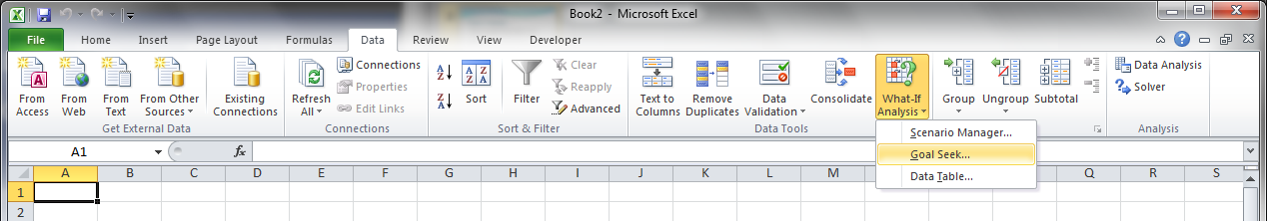
What-If Analysis
Excel has tools which will automatically vary the inputs to a problem to achieve a desired output
GOAL SEEK

Slide 3
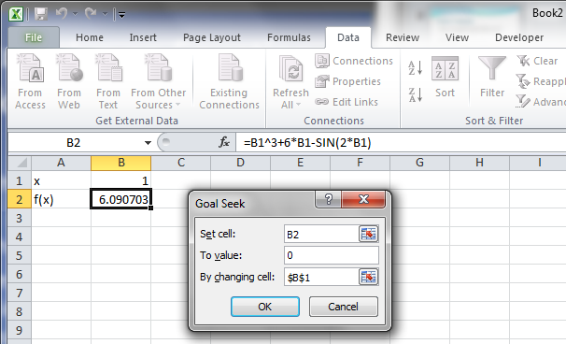
Using Goal Seek for Root-Finding
Goal Seek uses and iterative search to change the input (in cell B1 to the right) to achieve a desired result (from the formula in B2).
Goal Seek used most to find the roots of linear equations: f(x) = 0

Slide 4
Limitations of Goal Seeking
Linear equations have exactly one root – Goal Seek can always (quickly) find the root regardless of what initial input is chosen
Non-linear equations may have one, none, or many roots
Polynomials have a number of roots equal to the order; “general” non-linear equations have unknown number
Choice of initial input is critical
Goal Seek can only find a single (closest) root for any given initial input
Goal Seek may not be able to find a root at all if the initial input if too far from a root

Slide 5

In-Class Exercise #1
Use Goal Seek to find the root of the polynomial function below which lies in the range 0 ≤ x ≤ 5
First plot the residual of the function so that you can estimate the roots and enter reasonable initial values for Goal Seek
The in-class exercise problem statements are posted on myCourses so you can get straight to working the problem…
$$f\left(x\right)=4x^{3}−3x^{2}−30=0$$

Slide 6

In-Class Exercise #2
Use Goal Seek to find the root of the non-linear function below which lies in the range 0 ≤ x ≤ 1
First plot the residual of the function so that you can estimate the roots and enter reasonable initial values for Goal Seek
$$f\left(x\right)=3e^{2x}−10=0$$

Slide 7

In-Class Exercise #3
Use Goal Seek to find the root of the non-linear function below which lies in the range -1 ≤ x ≤ 1
First plot the residual of the function so that you can estimate the roots and enter reasonable initial values for Goal Seek
$$f\left(x\right)=5\left({10}^{x}\right)−10x^{2}=0$$

Slide 8
Solver
Solver is more powerful (and complicated) than Goal Seek
Solver can
Maximize or minimize functions
Set a given cell to a desired value
Perform constrained optimization (most important!)

Slide 9
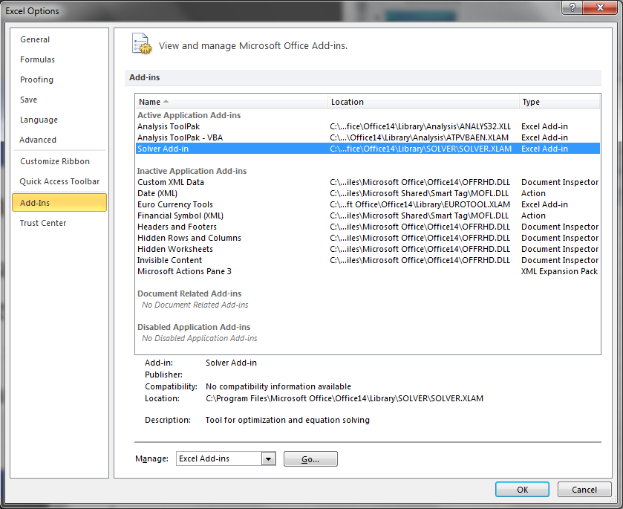
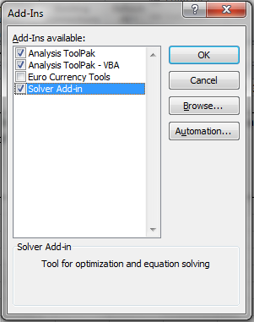
Solver
Solver is a another available data analysis tool
It may not be enabled by default in Excel!
From the File tab, click on Excel Options and choose Add-Ins on the left-hand side
If “Solver” not listed under “Active Add-Ins”, click “Go…” and check the box next to “Solver”, then click “OK”

Slide 10


Performing Optimization with the Solver
Any optimization problem has an “objective function”
and usually has constraint functions
$$f\left(x,y,z,…\right)→min. (or max., or 0)$$
$$C_{1}\left(x,y,z,…\right)≤0 \\ C_{2}\left(x,y,z,…\right)>0 \\ etc.$$

Slide 11
Performing Optimization with the Solver
If all of the functions (both objective and constraint) are linear, then the problem can be solved with the “Simplex” method of “linear programming”
If the functions are non-linear, then more complex (and occasionally less than 100% effective) methods must be used, some of which are available in Solver
Gradient method
Iterative method
Monte-Carlo method

